Slide 1
INTRODUCTION TO COMPUTING
Course Code: CCINCOM/L
Trees
Joseph Marvin R. Imperial
Faculty
Department of Computer Science
College of Computing and Information Technologies (CCIT)
National University
Joseph Marvin R. Imperial
DATA STRUCTURES AND ALGORITHMS
NU College of Computing and Information Technologies
Course Code: CCDATRCL

Slide 2
Linear data structures
Data structures can be used to solve problems.
An array is a good static data structure that can be accessed randomly and is fairly easy to implement.
Linked lists on the other hand is dynamic and is ideal for application that requires frequent operations such as add, delete, and update.
Stacks and queues that allows us to solve complicated problems (eg: maze traversal, parsing recursions, managing priorities)
Joseph Marvin R. Imperial
DATA STRUCTURES AND ALGORITHMS
NU College of Computing and Information Technologies
Course Code: CCDATRCL

Slide 3
Disadvantages of linear data structures
One of the disadvantages of using an array or linked list to store data is the time needed to search for an item.
Since both the arrays and Linked Lists are linear structures the time required to search a “linear” list is proportional to the size of the data set.
Meanwhile, stacks and queues are not normally used for searching or storage.
Joseph Marvin R. Imperial
DATA STRUCTURES AND ALGORITHMS
NU College of Computing and Information Technologies
Course Code: CCDATRCL

Slide 4
How about a data structure with multiple relations? Will it speed up the process?
Enter the tree data structure.
Joseph Marvin R. Imperial
DATA STRUCTURES AND ALGORITHMS
NU College of Computing and Information Technologies
Course Code: CCDATRCL

Slide 5
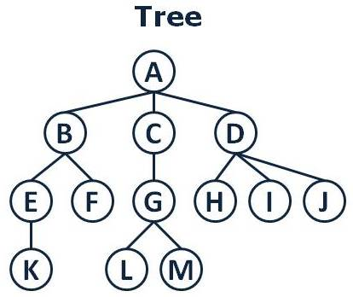
Tree/s
A tree is a nonlinear data structure in contrast to linked lists, arrays, stacks, and queues.
A tree is a collection of nodes connected by edges.
Joseph Marvin R. Imperial
DATA STRUCTURES AND ALGORITHMS
NU College of Computing and Information Technologies
Course Code: CCDATRCL

Slide 6
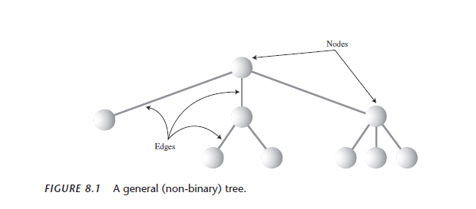
Joseph Marvin R. Imperial
DATA STRUCTURES AND ALGORITHMS
NU College of Computing and Information Technologies
Course Code: CCDATRCL

Slide 7
Properties of a tree
One node is distinguished as a root.
Every node (exclude a root) is connected by an edge from exactly one other node.
A direction is: parent -> children
A tree can be empty with no nodes or a tree is a structure consisting of one node called the root and zero or one or more subtrees.
Each node can have arbitrary number of children.
No cycles, no sharing of nodes.
Joseph Marvin R. Imperial
DATA STRUCTURES AND ALGORITHMS
NU College of Computing and Information Technologies
Course Code: CCDATRCL

Slide 8
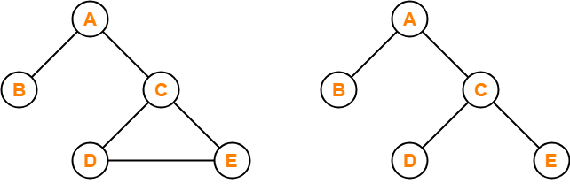
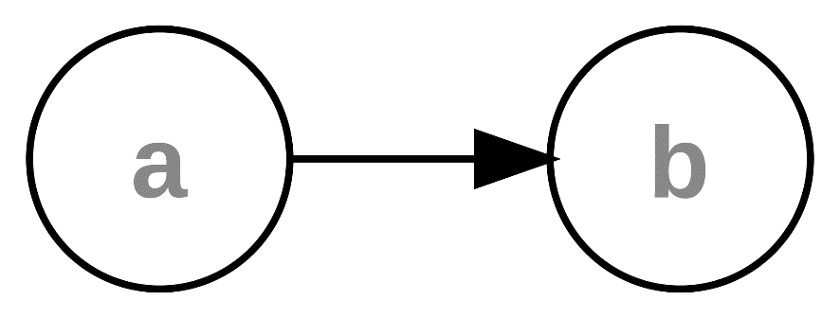


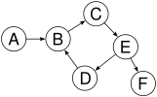

Which is a tree? Which is not?
Joseph Marvin R. Imperial
DATA STRUCTURES AND ALGORITHMS
NU College of Computing and Information Technologies
Course Code: CCDATRCL

Slide 9
Terminologies of a tree
Node - node is a structure which may contain a value or condition, or represent a separate data structure.
Root - the top node in a tree, the prime ancestor.
Child - a node directly connected to another node when moving away from the root, an immediate descendant.
Parent - the converse notion of a child, an immediate ancestor.
Siblings - a group of nodes with the same parent.
Joseph Marvin R. Imperial
DATA STRUCTURES AND ALGORITHMS
NU College of Computing and Information Technologies
Course Code: CCDATRCL

Slide 10
Terminologies of a tree
Leaf - a node with no children.
Internal node - a node with at least one child.
Degree - for a given node, its number of children. A leaf is necessarily degree zero.
Edge - the connection between one node and another.
Path - A sequence of nodes and edges connecting a node with a descendant.
Joseph Marvin R. Imperial
DATA STRUCTURES AND ALGORITHMS
NU College of Computing and Information Technologies
Course Code: CCDATRCL

Slide 11
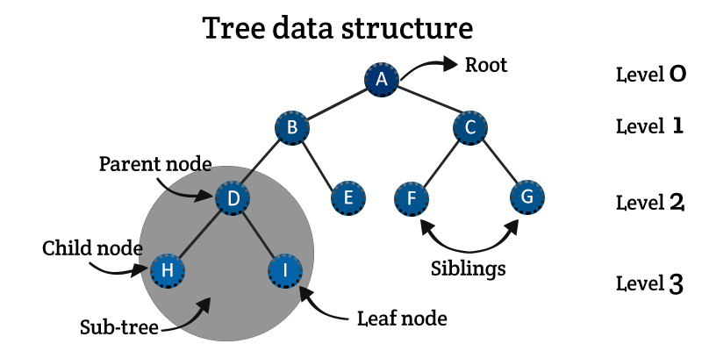
Terminologies of a tree
Joseph Marvin R. Imperial
DATA STRUCTURES AND ALGORITHMS
NU College of Computing and Information Technologies
Course Code: CCDATRCL

Slide 12
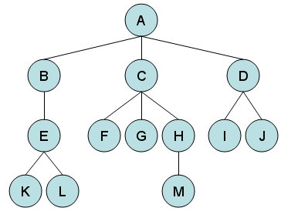
Identify the parts
Joseph Marvin R. Imperial
DATA STRUCTURES AND ALGORITHMS
NU College of Computing and Information Technologies
Course Code: CCDATRCL

Slide 13
Types of trees
General trees
Binary trees
Binary search trees
Decision trees*
*for the sake of the project
Joseph Marvin R. Imperial
DATA STRUCTURES AND ALGORITHMS
NU College of Computing and Information Technologies
Course Code: CCDATRCL

Slide 14
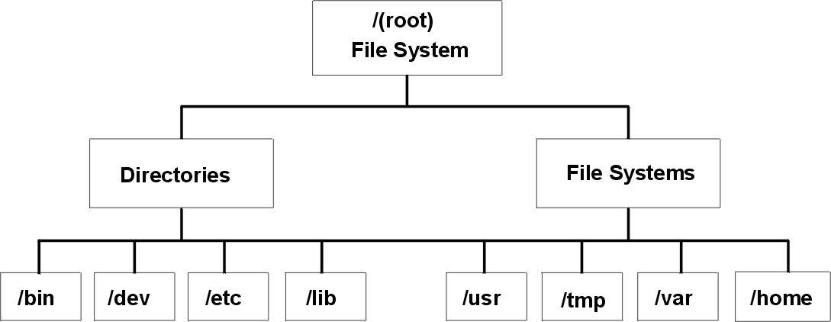
General trees
A general tree is a tree where each node may have zero or more children (a binary tree is a specialized case of a general tree).
General trees are used to model applications such as file systems.
Joseph Marvin R. Imperial
DATA STRUCTURES AND ALGORITHMS
NU College of Computing and Information Technologies
Course Code: CCDATRCL

Slide 15
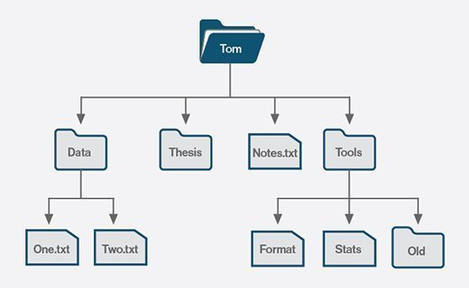
File systems
Joseph Marvin R. Imperial
DATA STRUCTURES AND ALGORITHMS
NU College of Computing and Information Technologies
Course Code: CCDATRCL

Slide 16
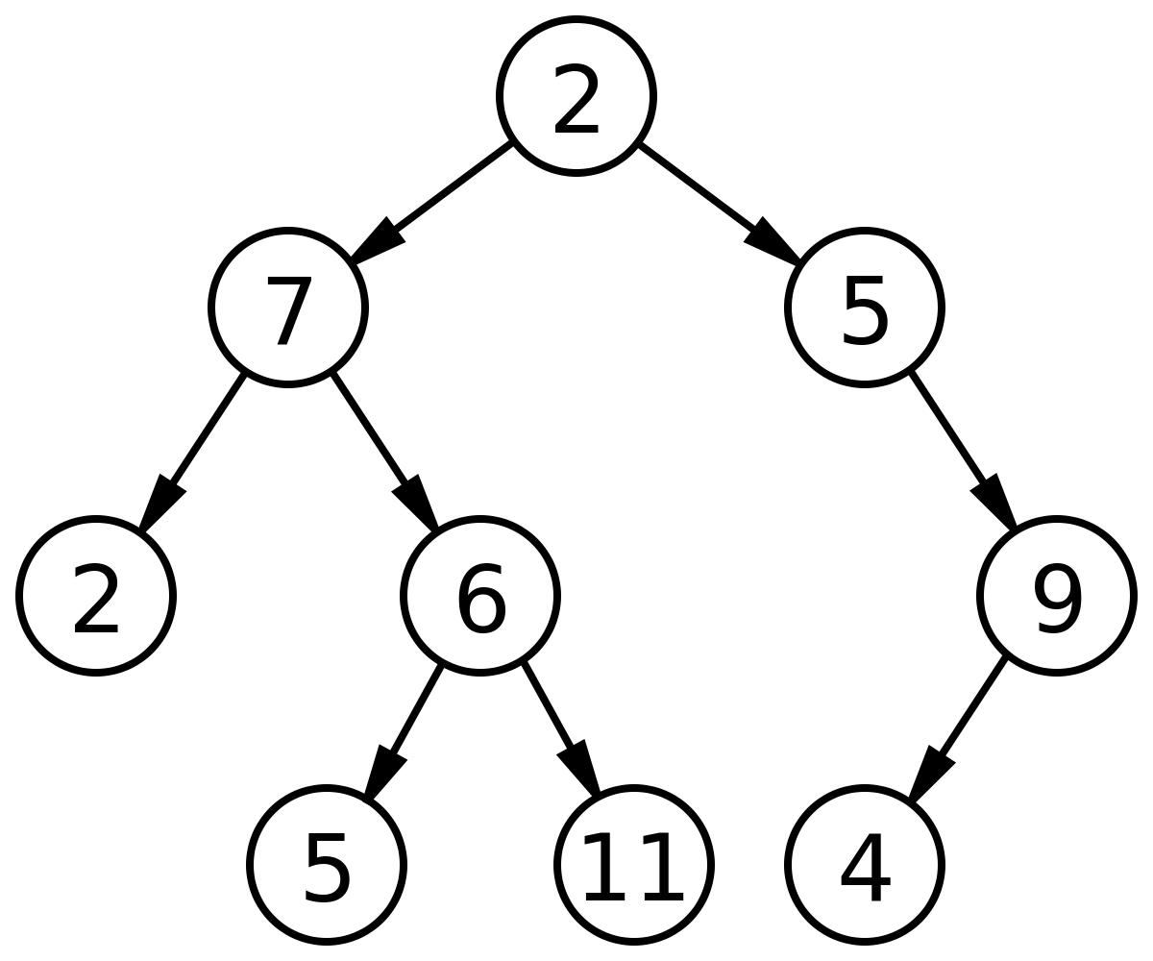
Binary trees
Binary tree is a data structure in which each node can have at most 2 children.
The simplest and the most common tree type. We will focus more on this type of tree.
Joseph Marvin R. Imperial
DATA STRUCTURES AND ALGORITHMS
NU College of Computing and Information Technologies
Course Code: CCDATRCL

Slide 17
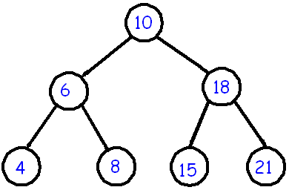
Binary search trees
Binary search tree is an ordered binary tree.
All the elements in the left sub-tree are less than the root while elements in the right sub-tree are greater than or equal to the root node element.
Binary search trees are used in most of the applications of computer science domain like searching, sorting, etc.
Joseph Marvin R. Imperial
DATA STRUCTURES AND ALGORITHMS
NU College of Computing and Information Technologies
Course Code: CCDATRCL

Slide 18
Binary search trees
Convert into a binary search tree:
{30, 15, 60, 7, 22, 45, 75, 17, 27}
{11, 6, 19, 4, 8, 17, 43, 5, 10, 31, 49}
Joseph Marvin R. Imperial
DATA STRUCTURES AND ALGORITHMS
NU College of Computing and Information Technologies
Course Code: CCDATRCL

Slide 19
Decision trees
A decision tree is a flowchart-like structure in which each node represents a “test” on an attribute and each branch / edge represents the outcome of the test
An implementation of a general tree which using decisions as edges of the nodes.
Joseph Marvin R. Imperial
DATA STRUCTURES AND ALGORITHMS
NU College of Computing and Information Technologies
Course Code: CCDATRCL

Slide 20
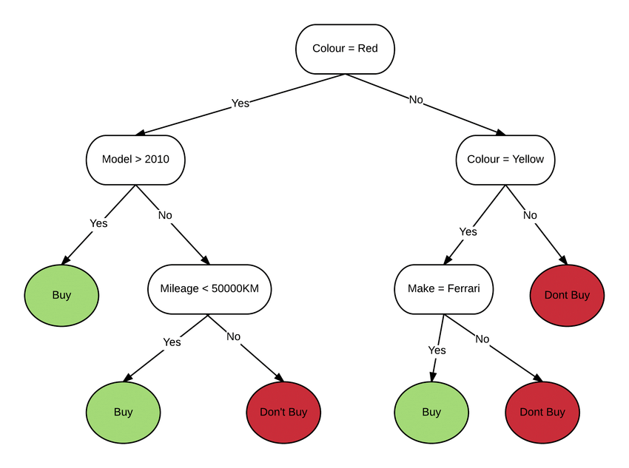
Decision trees
Joseph Marvin R. Imperial
DATA STRUCTURES AND ALGORITHMS
NU College of Computing and Information Technologies
Course Code: CCDATRCL

Slide 21
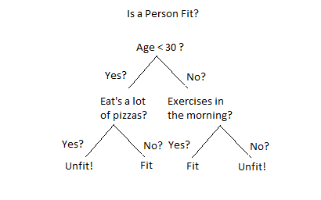
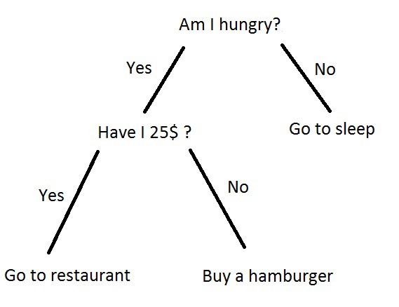
Decision trees
Joseph Marvin R. Imperial
DATA STRUCTURES AND ALGORITHMS
NU College of Computing and Information Technologies
Course Code: CCDATRCL

Slide 22
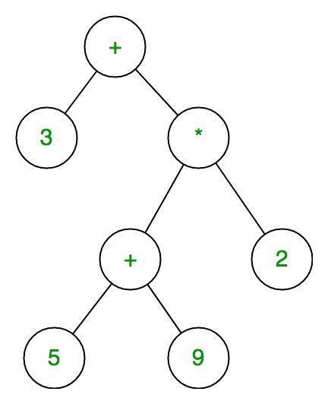
Expression trees
An expression tree is a representation of expressions arranged in a tree-like data structure.
In other words, it is a tree with leaves as operands of the expression and nodes contain the operators.
Example: 3 + ((5+9)*2)
Joseph Marvin R. Imperial
DATA STRUCTURES AND ALGORITHMS
NU College of Computing and Information Technologies
Course Code: CCDATRCL

Slide 23
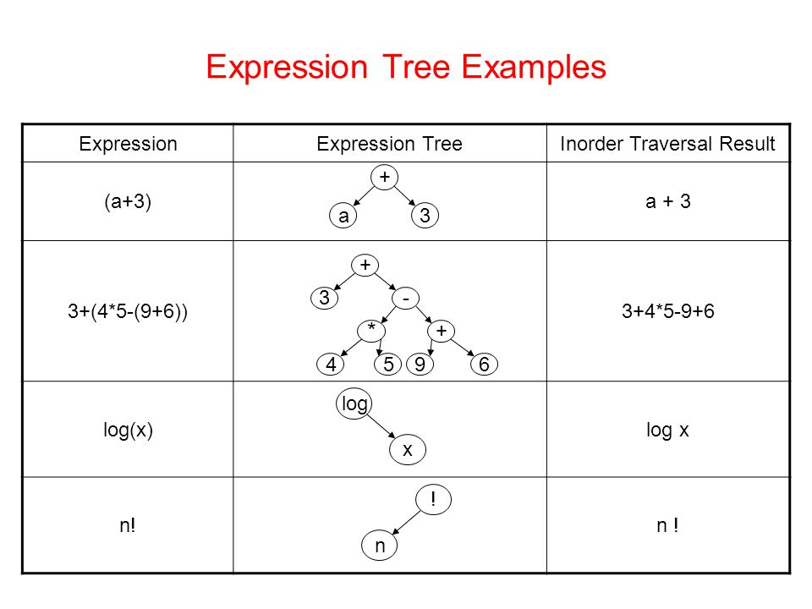
Joseph Marvin R. Imperial
DATA STRUCTURES AND ALGORITHMS
NU College of Computing and Information Technologies
Course Code: CCDATRCL

Slide 24
Advantages of a tree
Trees reflect structural relationships in the data
Trees are used to represent hierarchies (ex. max heap, structure with priority)
Trees provide an efficient insertion and searching
Trees are very flexible data, allowing to move subtrees around with minimum effort
Joseph Marvin R. Imperial
DATA STRUCTURES AND ALGORITHMS
NU College of Computing and Information Technologies
Course Code: CCDATRCL

Slide 25
Applications of a tree
Trees are used to model applications such as file systems.
Used for recurrence relations in computer science.
An efficient search data structure (O(log N)).
Used in parsing expressions for programming languages.
Implement a faster priority queue.
Routing algorithms.
Joseph Marvin R. Imperial
DATA STRUCTURES AND ALGORITHMS
NU College of Computing and Information Technologies
Course Code: CCDATRCL

Slide 26
References
Carnegie Mellon University – Data Structures: http://www.cs.cmu.edu/~clo/www/CMU/DataStructures/Lessons/lesson4_1.htm
Joseph Marvin R. Imperial
DATA STRUCTURES AND ALGORITHMS
NU College of Computing and Information Technologies
Course Code: CCDATRCL

